Slide 1
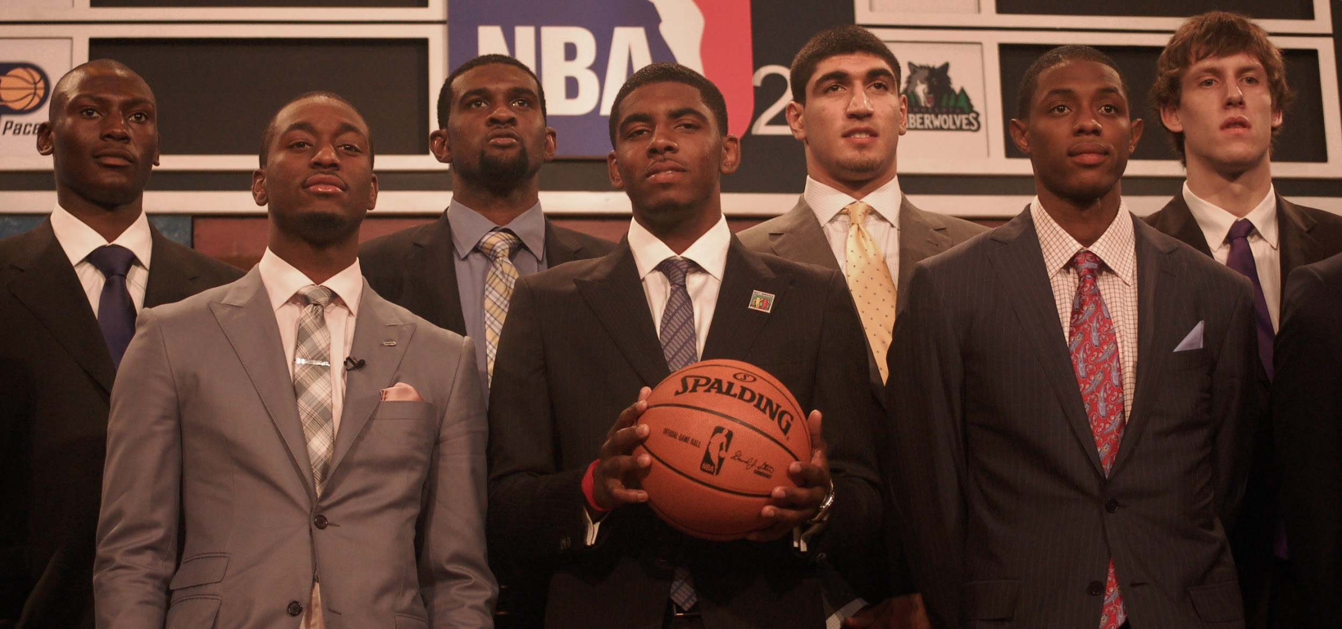
College Basketball Draft
Project
Machine Learning
Contributors:
Thomas Martin
Marisa Kiger
Galen Kellner
Dwayne Jordan

Slide 2

Project Overview
Principle:
Develop a Machine Learning model to predict if a basketball player will go professional based on their player stats.
Objectives:
Find a large source of meaningful data.
Create a training model.
Test the training model.
Measure output predictions for accuracy.

Slide 3
Data Collection - Finding Big Data
Web-scraping code was used to scrape data from the site Sports Reference https://www.sports-reference.com/. The code was specified to pull data for eleven key player stat parameters:
fgapg = Field goal attempts per game
fgpct = Field goal percent
fgpg = Field goals per game
ftapg = Free throw attempts per game
ftpct = Free throw percent
ftpg = Free throws per game
height = Player height
pfpg = Personal fouls per game
ptspg = Points per game
sospg = Strength of schedule
trbpg = Total rebounds per game

Slide 4
Data Preprocessing
SQL – Created schema code to create a database of all players scraped from web.
Created a query to cycle through and view names and stats of players who went pro and those who did not.
Combined data sets in order to view a side by side comparison of pro player stats while still in the NCAA vs in the NBA.
‘is_pro’ column added assigning players with a binary response 1 = played professionally and 0 = no professional statistics.
The height column was converted to inches for analysis.
Rows containing NAN values were removed.
Data was split into two separate dataframes “train” and “test”.

Slide 5
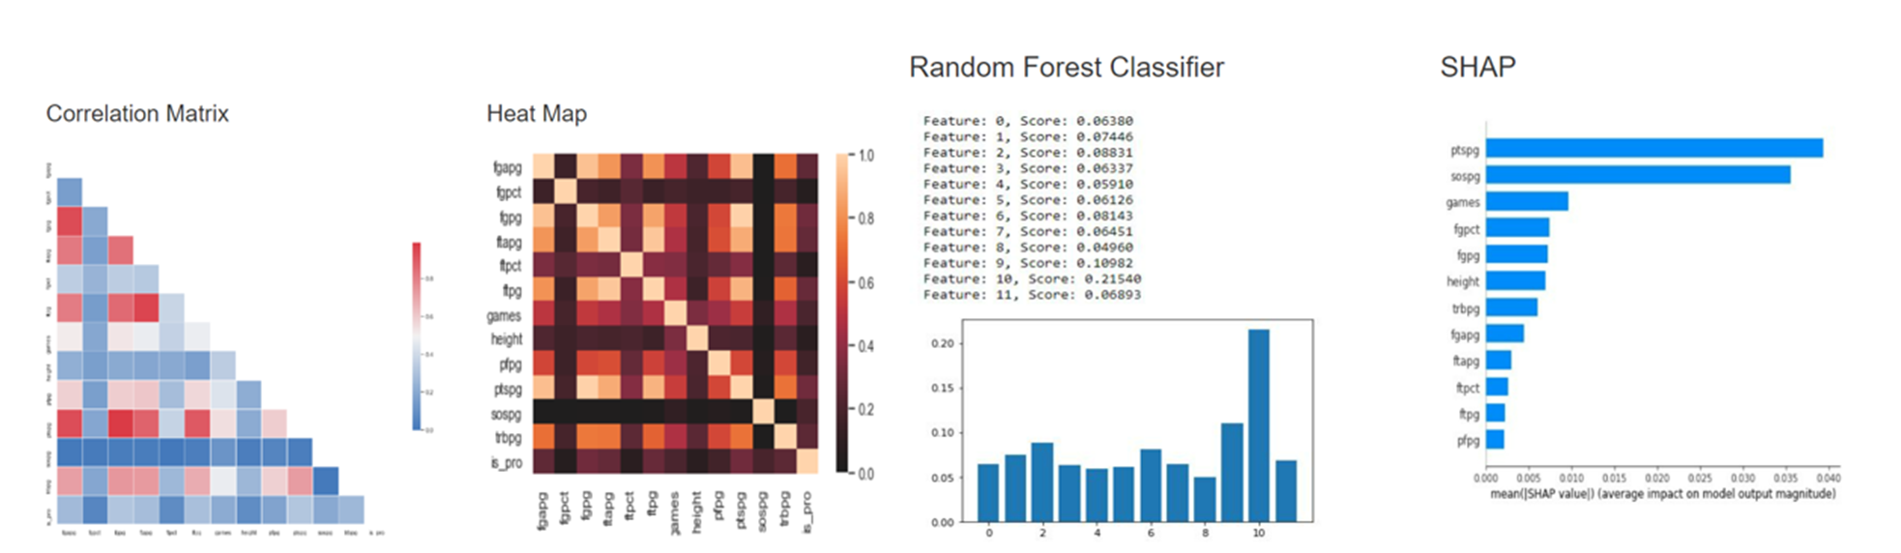
Model Training
The “train” data set was further split into a train test subsets and input through our models. Features were assessed through a Correlation Matrix, Heat Map, Random Forest Classifier, and a SHAP representation. In the end the Random Forest Classifier showed a potential for training with multiple features.

Slide 6
Model Test
Testing the prediction Accuracy:
The “test” dataframe player stats were input through the model to output the prediction for a player going professional.
Known values and names were removed to only push player stats through the model.
The predicted outputs were added to a dataframe along side the known outcome. To assess correct prediction.
The predicted outcomes matched for 38533 of 39836 inputs. Model showed a 96.7% prediction accuracy!

Slide 7
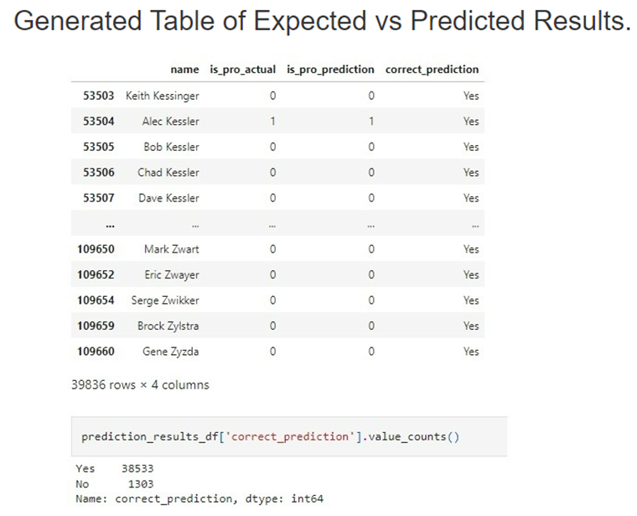
Findings:
Our model showed an ability to not only assess several features but produce a high accuracy for predicting the outcomes. The Random Forest Classifier model proved to be the most flexible model of our attempts. It allowed for all eleven parameters to be input without decreasing the accuracy. Overall this approach can be considered effective for evaluating the potential of a basketball player going professional.

Slide 8
Reflections:
Data set for model prediction must be new and previously unseen or the computer will recognize the prior data.
Data collection over time changed and improved. This added an extra layer of choosing the correct stats to have meaningful data.
Model accuracy can be difficult to assess prior to completing the prediction phase. The outcome results were a much more true reflection of the accuracy of the training model.
Teamwork is crucial for a project of this complexity. Many obstacles presented along the way that we were able to confront and overcome with a team approach.

Slide 9
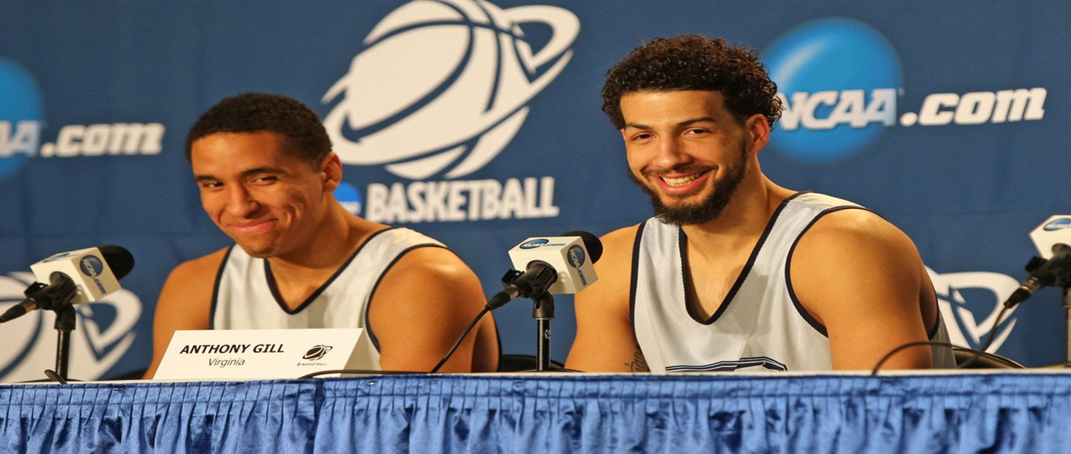
Questions?

Slide 10
For more information…
Visit our pages:
Project Web Site:
https://deepzissou.github.io/Draft_Prediction_Project/
GitHub Draft_Prediction_Project
deepzissou/Draft_Prediction_Project (github.com)

